Slide 1


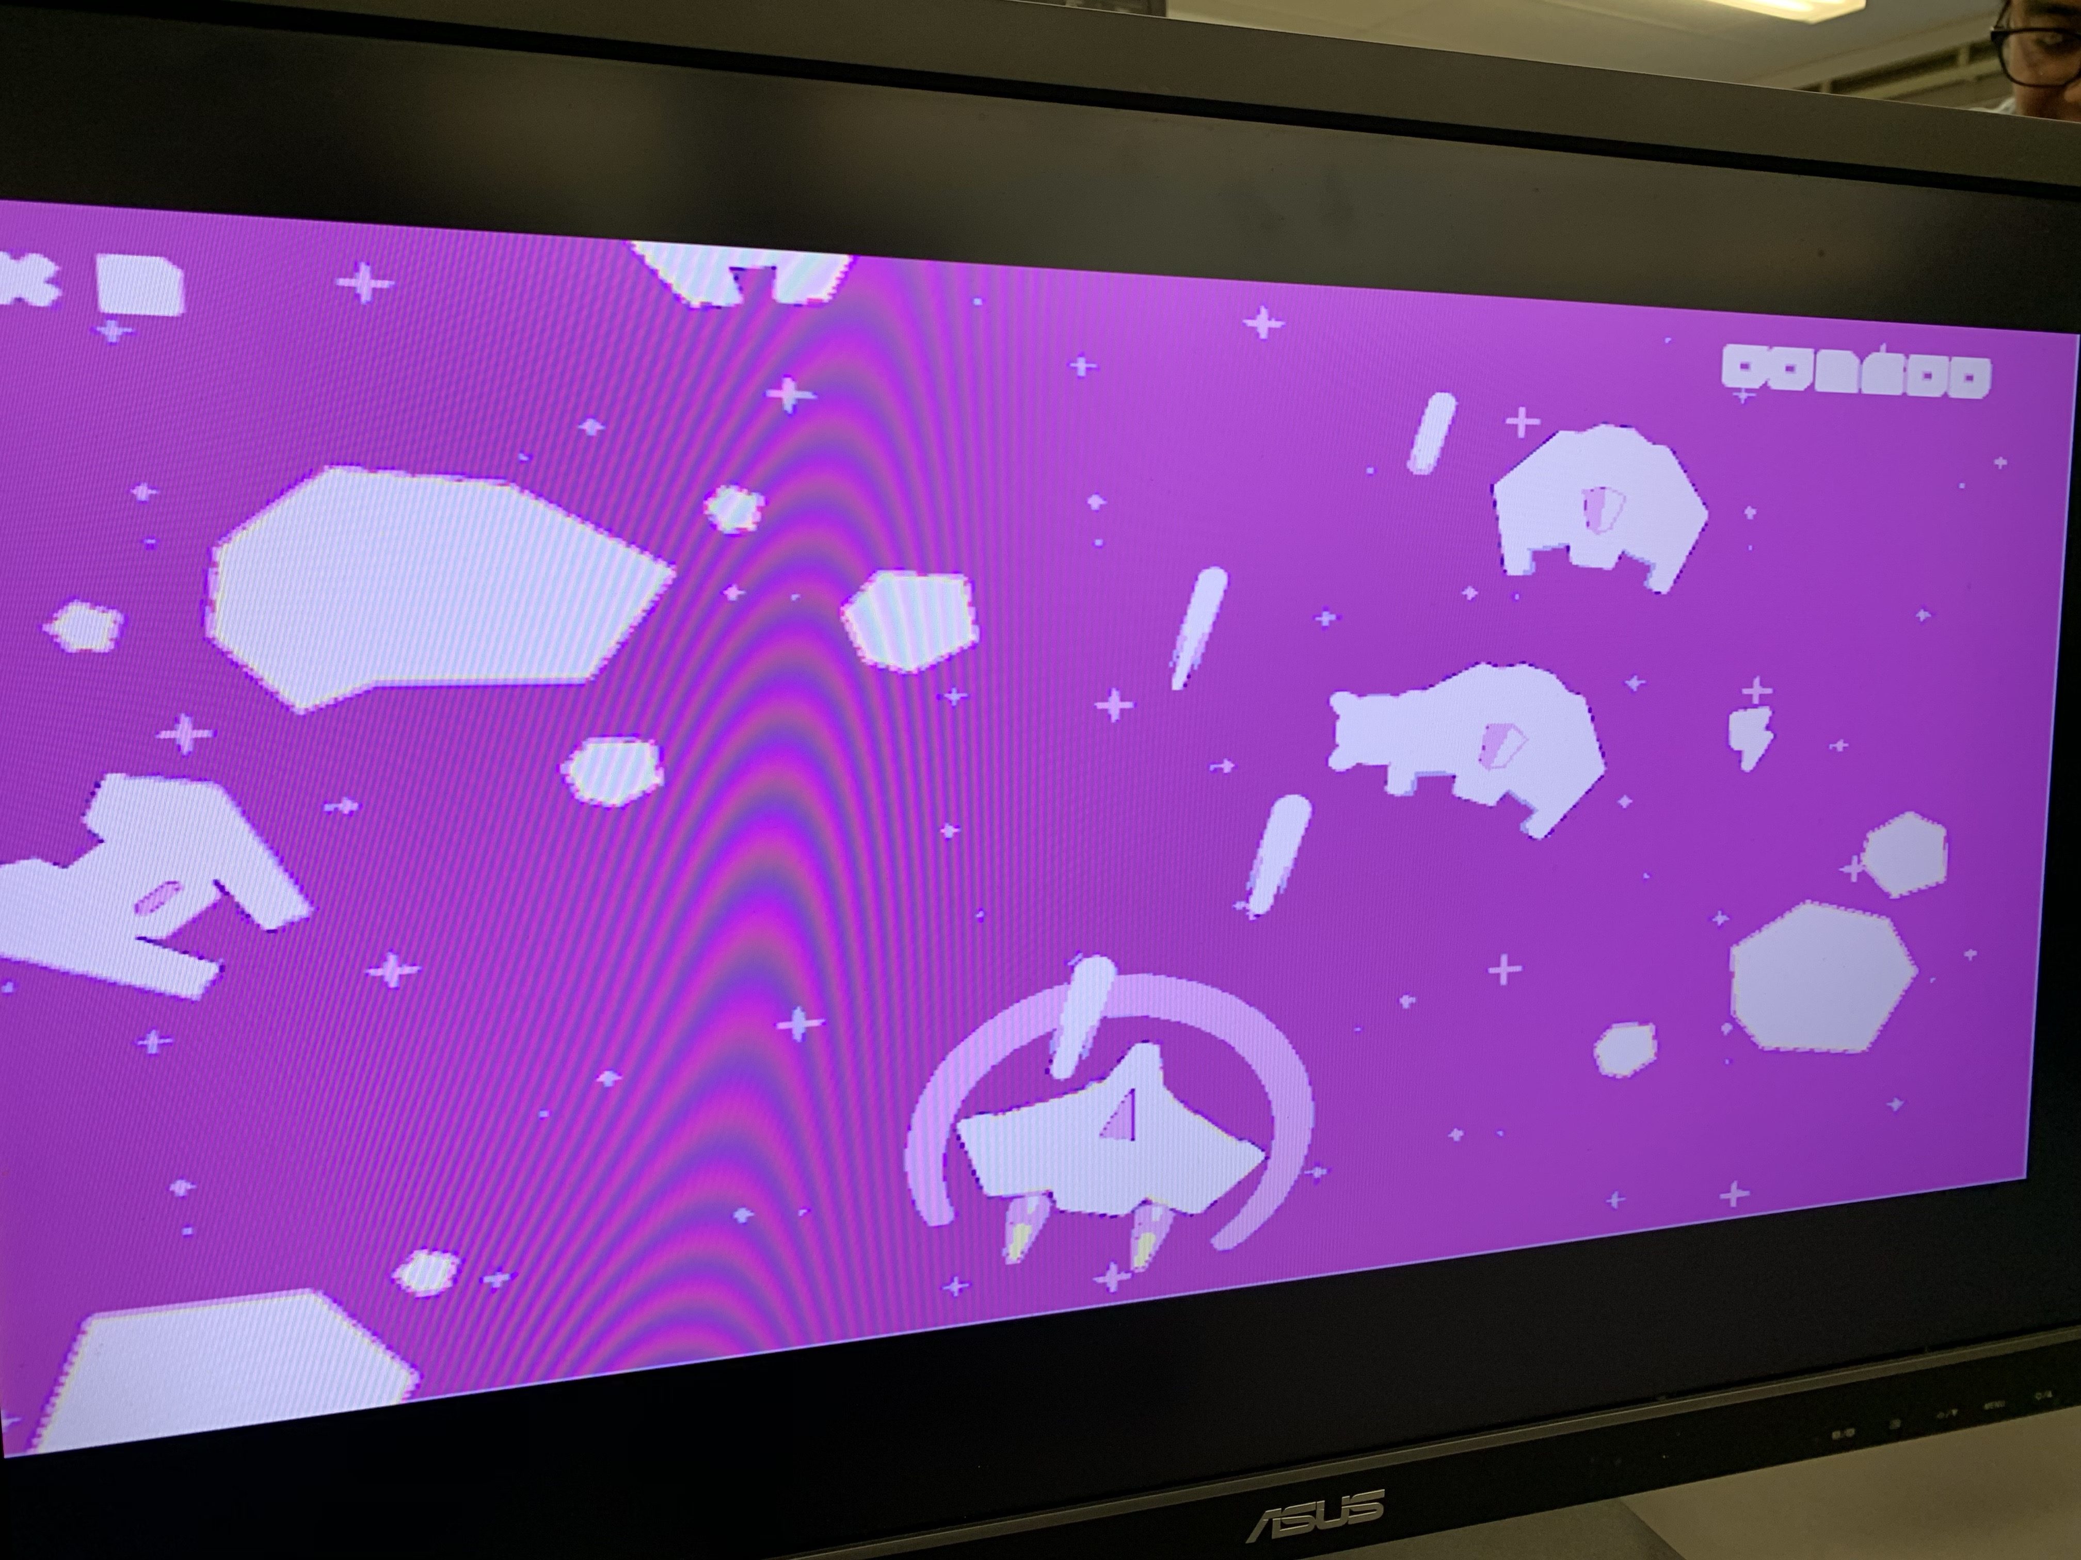
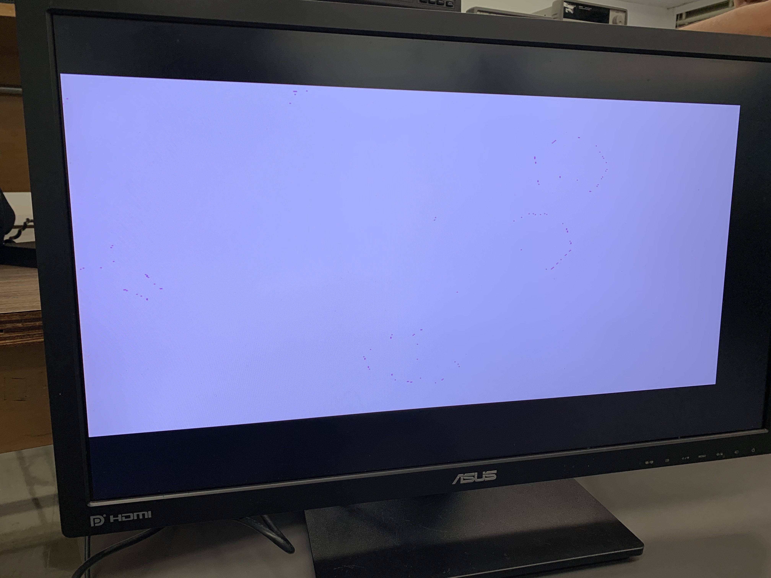
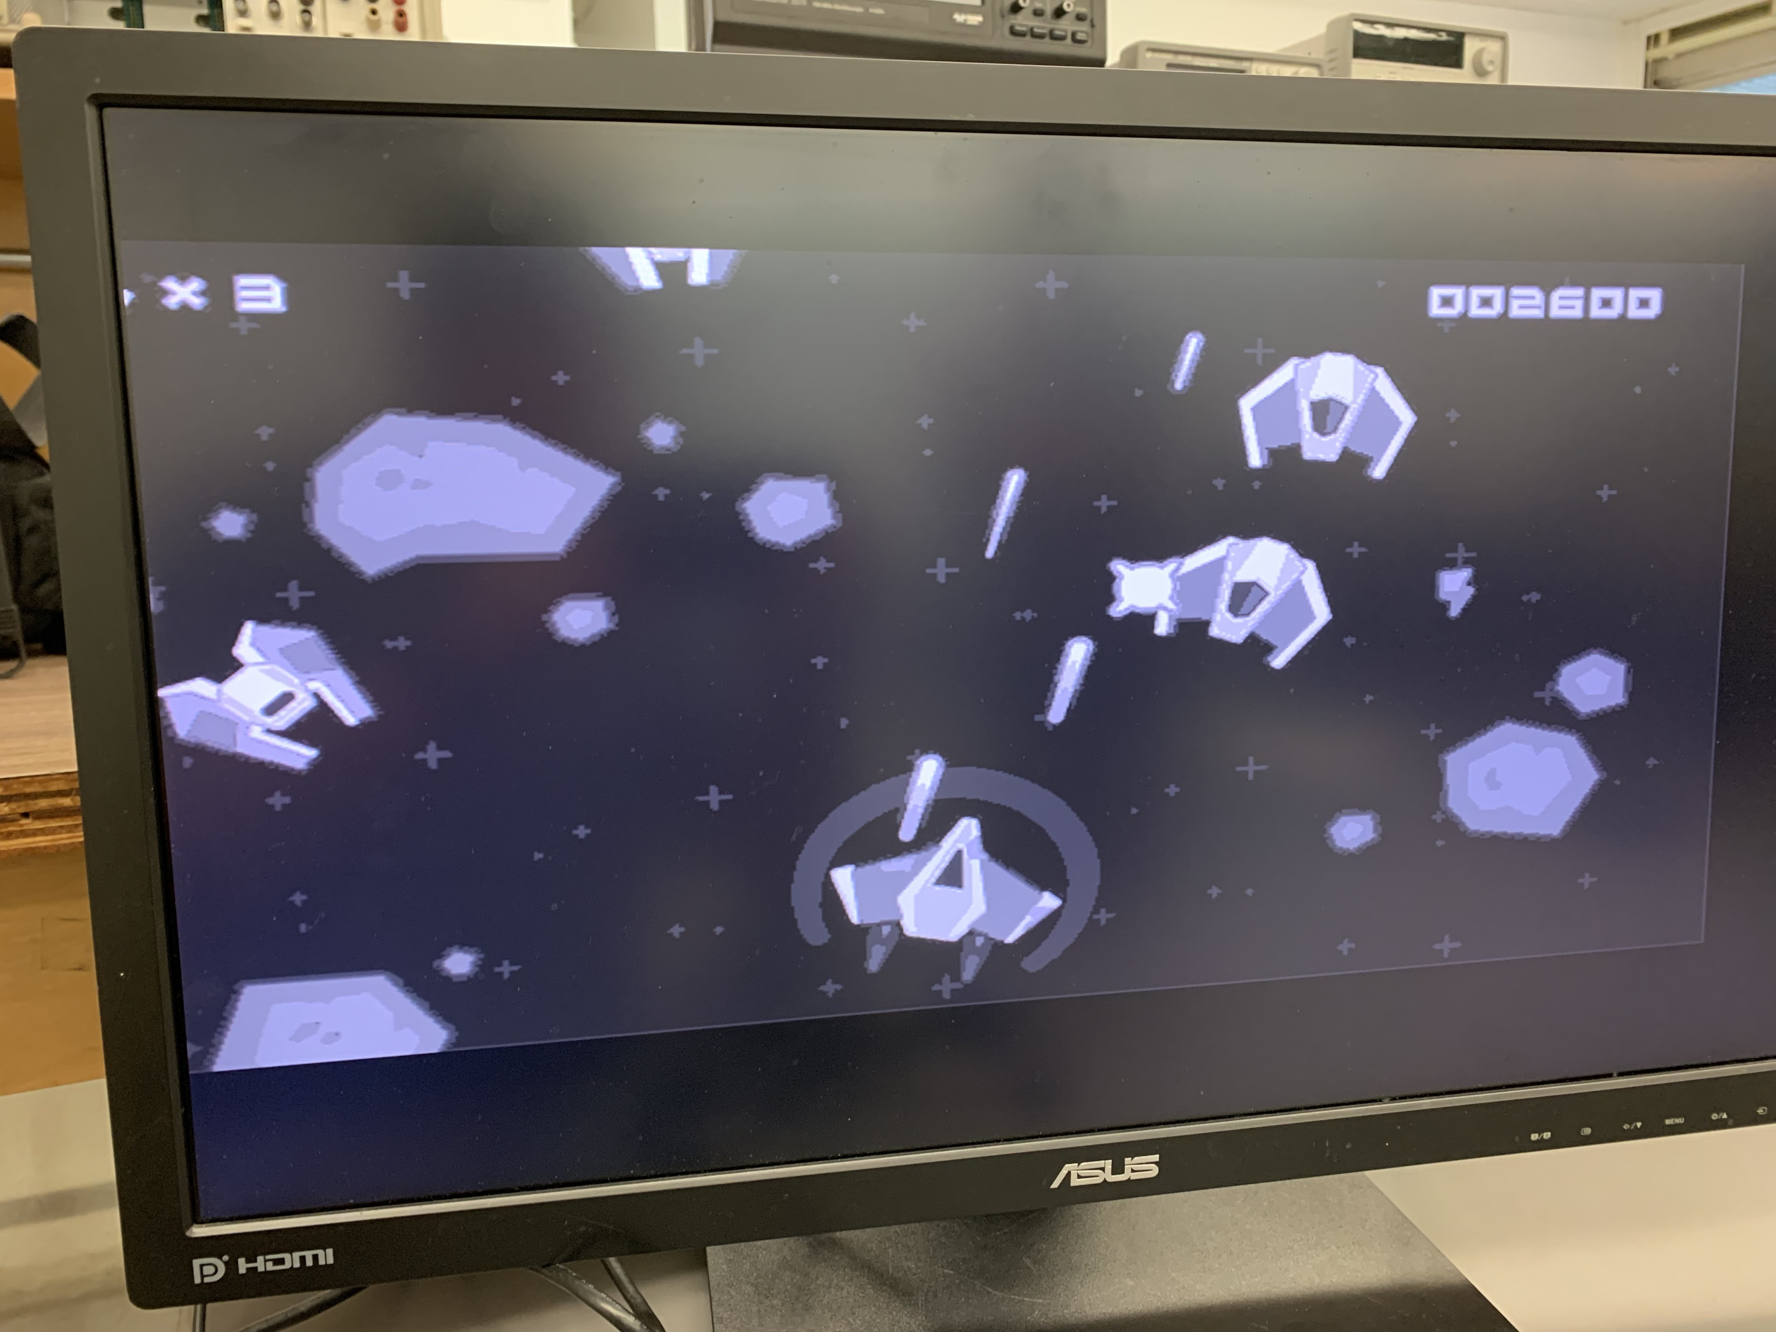
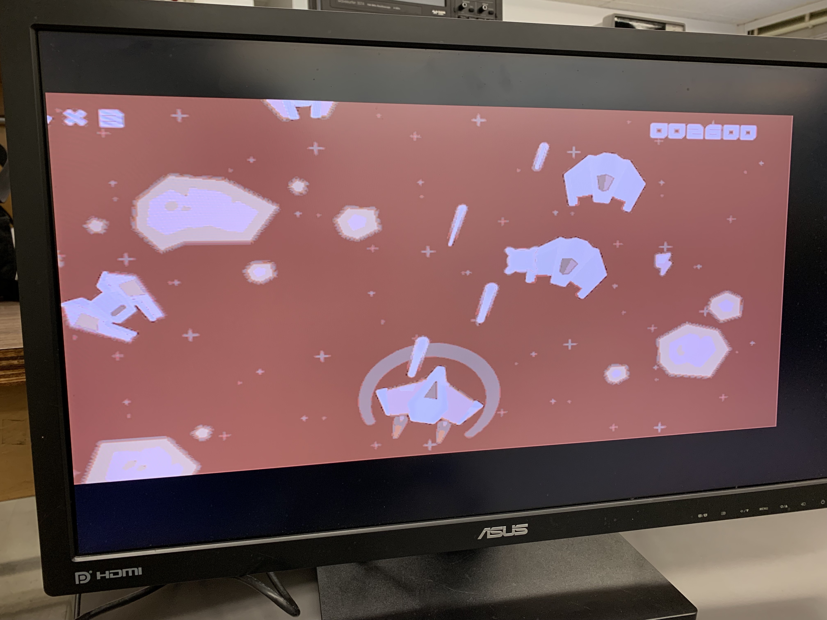
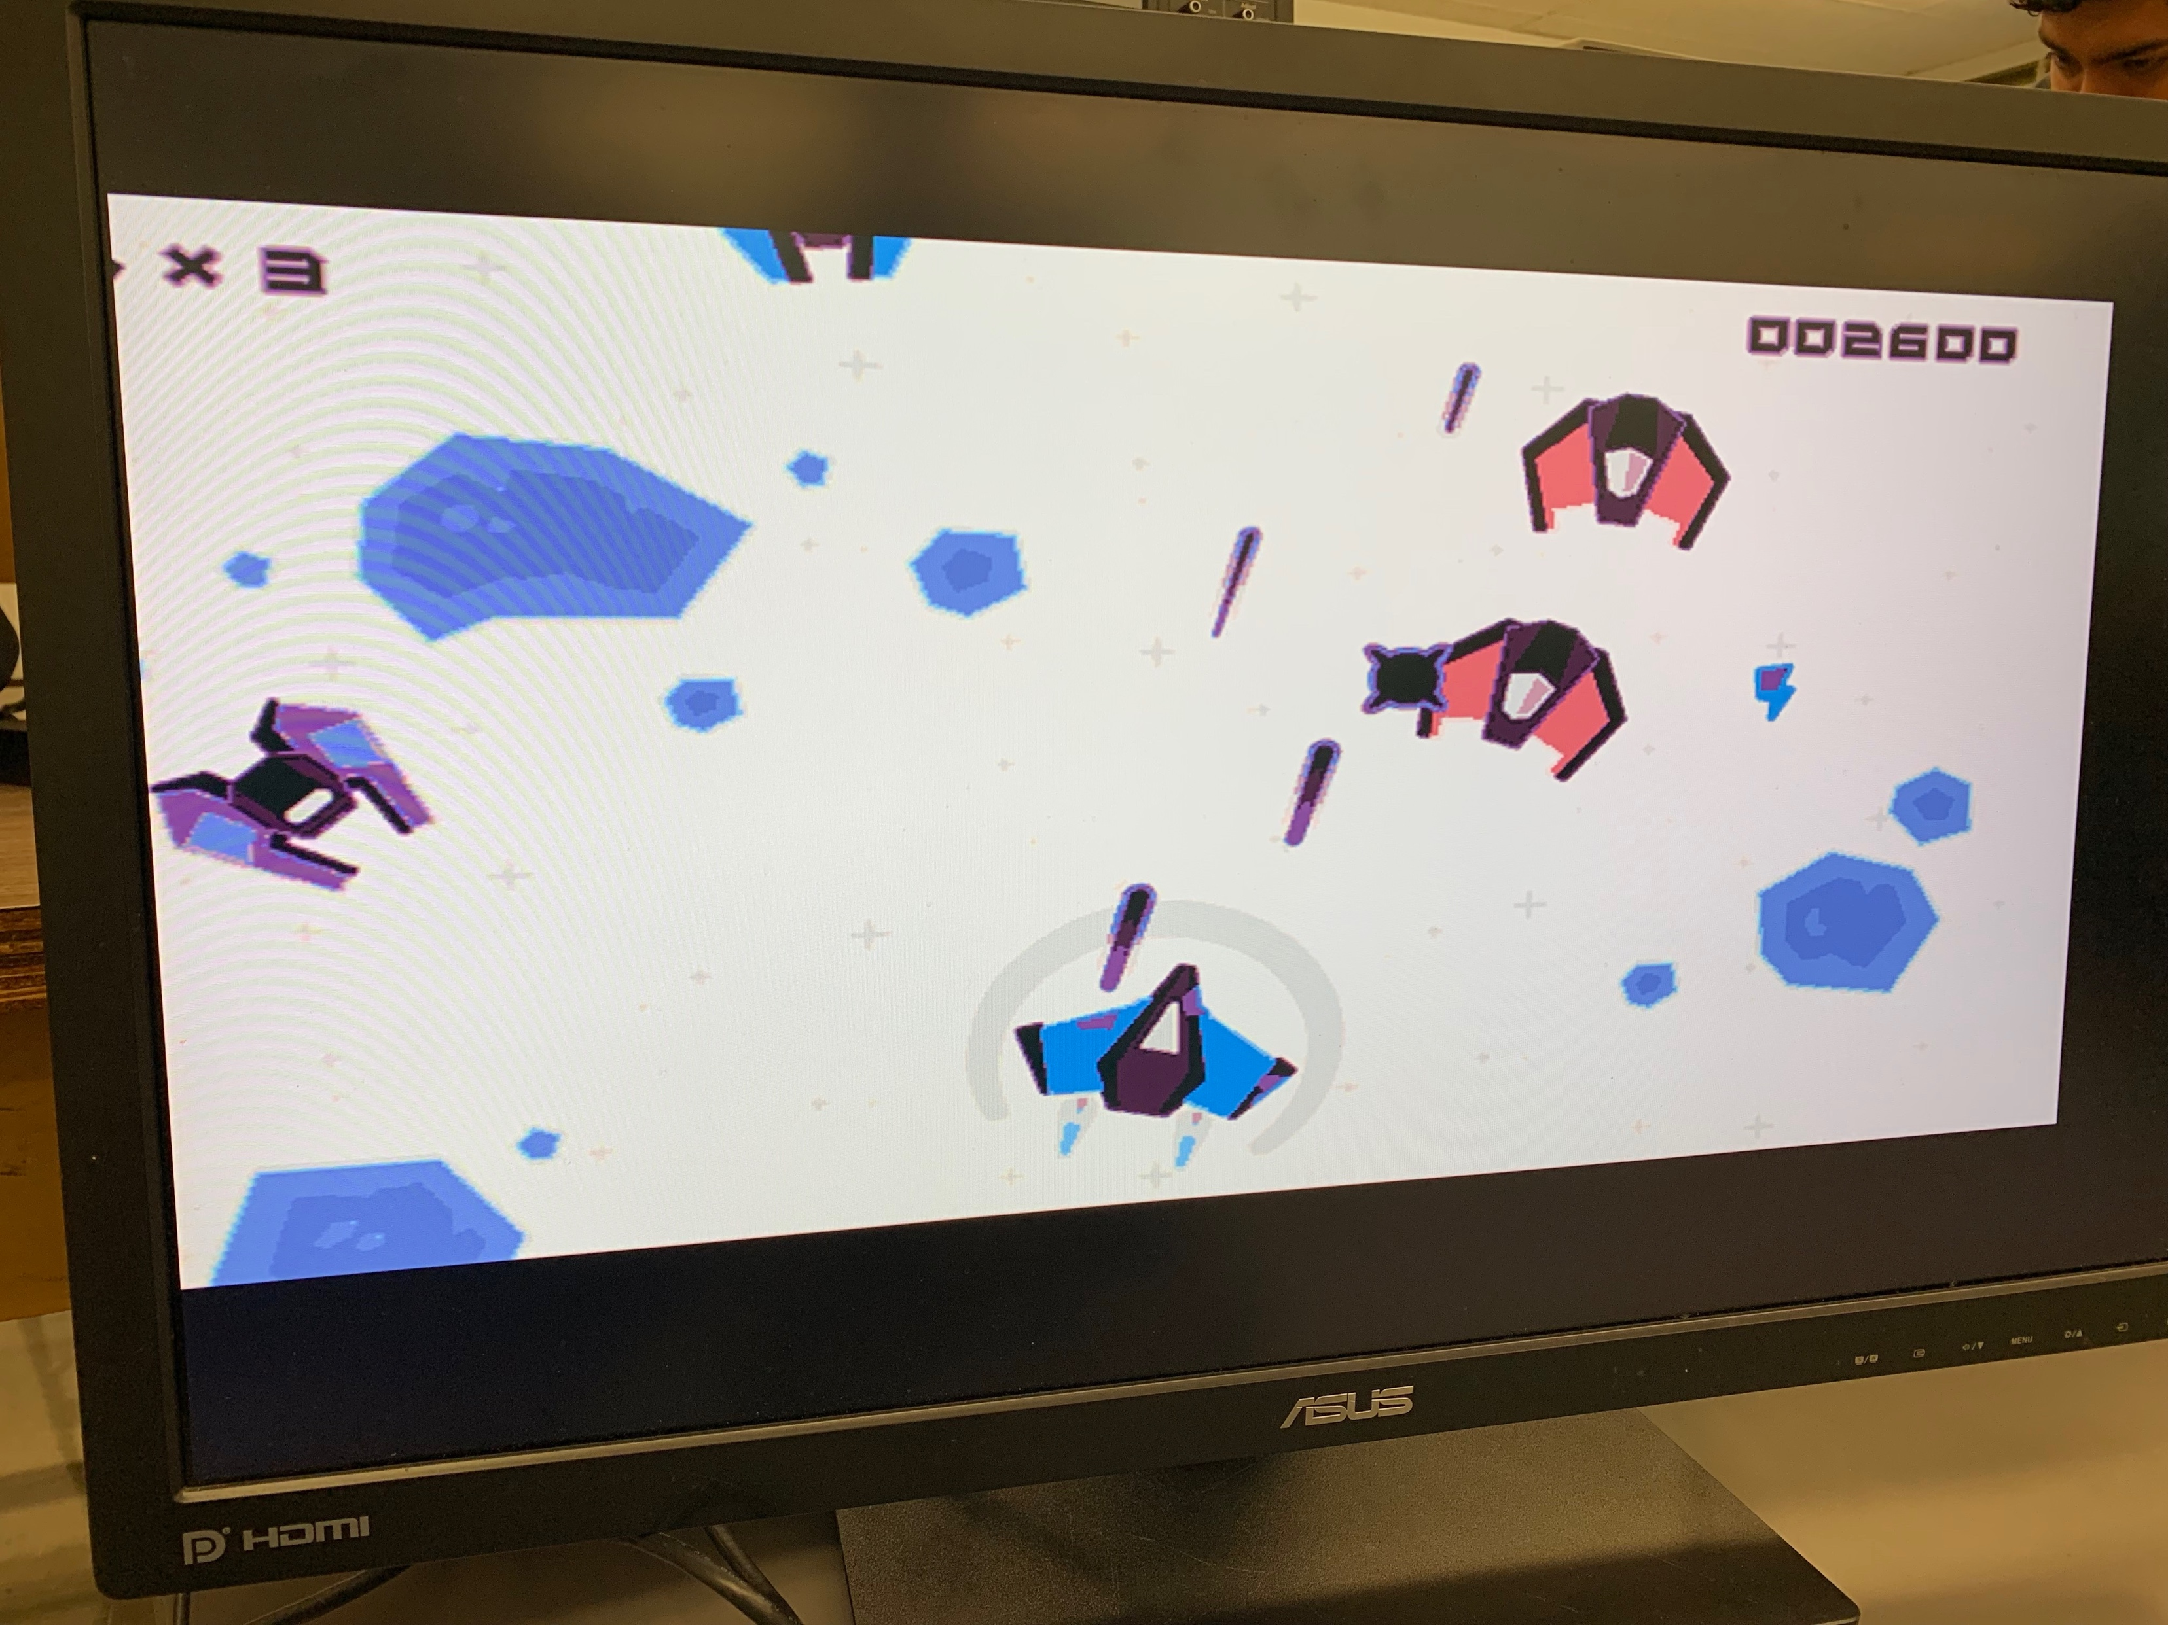

Image Processing on FPGA Team Members: Harrison Hsieh, Sergio Minera, Samuel Holt, Ivan Garcia, Alexander Ulrichsen Computer Architecture Dr. Aly May 1, 2019
Abstract
Examples
Brightness
There are many known resources and libraries for processing images through software applications. Instead, we developed a hardware implementation of an image processor which can manipulate images to perform various alterations such as adjusting brightness, encrypting the image, inverting the image, and changing the image to greyscale. The image can then be output directly from the FPGA to a monitor through VGA output. .
Greyscale
Background Research
Image Processing
Adjust Brightness
Greyscale
Encryption
Inversion
VGA Display
Output to monitor via VGA port
640 x 360 Resolution
SRAM
Storing pictures as .mem files
Challenges
Synthesizing code on FGPA
Implementing image effects
Overflow when allowing user input
Examples
Encryption
Constraints
Limited memory of FPGA board
Limited output resolution
Certain ideas would not be synthesizable on FPGA board
Inversion
Future Work
Some further applications would be to add more image adjustments, effects, and filters. The board could support more effects without using much more resources because the effects simply directly manipulate the images. Some further effects could be sharpening the image, adjusting the colors directly, adding a watermark, and adjusting the image blur.
Conclusion
The goal of this project was to implement an image processor using techniques learned in the class. We were able to create a hardware implementation of an image processor which is able to change various aspects of the supplied images and display them using a VGA output. This project could be extended to incorporate new aspects without changing much of the image processing design since that design only relies on modifying the bitmaps of the images.
References
[1] ECE 4300 Class Material. Dr. Mohamed Aly. 2019.
[2] Helland, Tanner. “Seven Grayscale Conversion Algorithms (with Pseudocode and VB6 Source Code).” Tanner Helland (Dot) Com, 4 June 2012, www.tannerhelland.com/3643/grayscale-image-algorithm-vb6/.

